Slide 1

Nick’s Medium CTF
File Analysis.

Slide 2
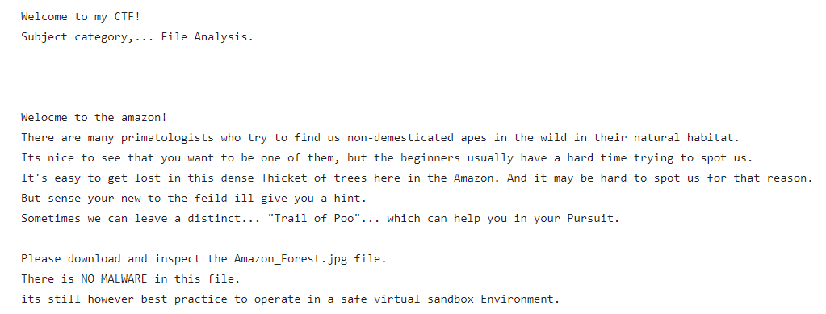
- Read the introduction. - Download the “Amazon_Forest.jpg” file.

Slide 3

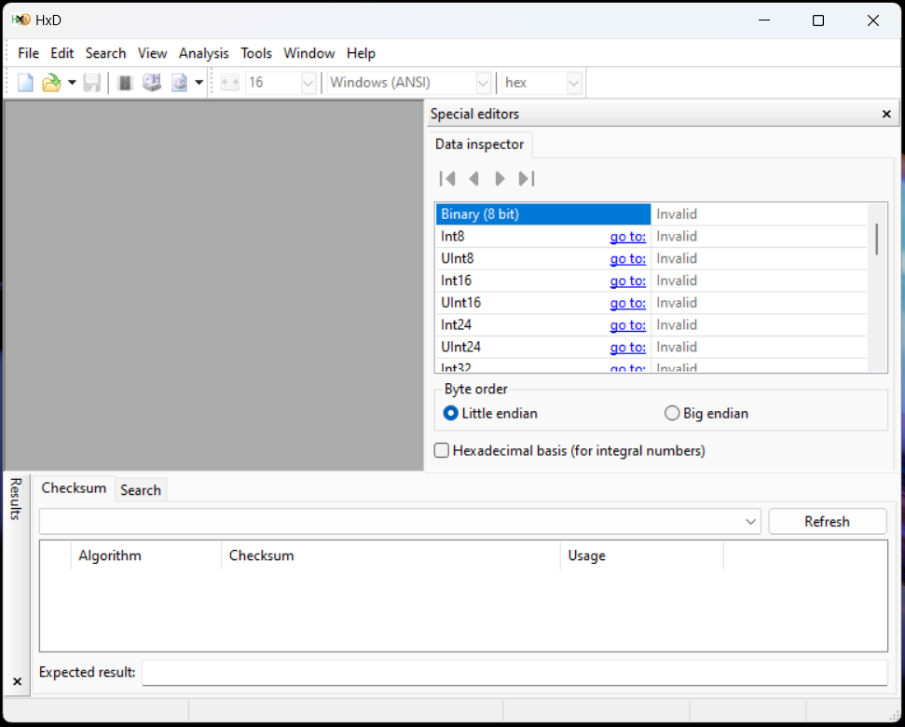
- Research online to discover the existence of “hex editors” - Find a hex editor such as “hxd”. - Download and install.

Slide 4
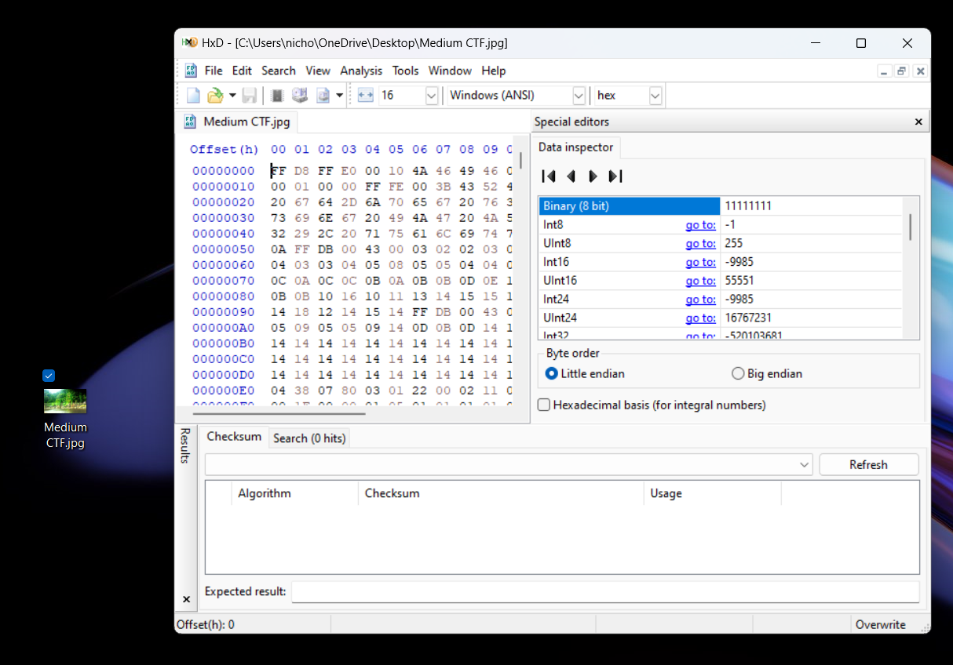
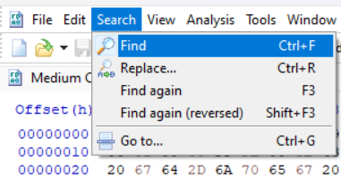
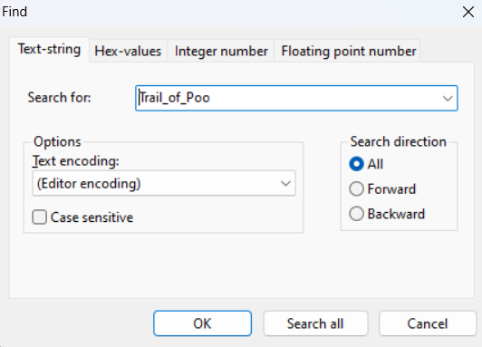
- Open .jpg file in a the hex editor. - Use the clue in the introduction to the CTF to use the hex editor to search for "Trail_of_Poo“.

Slide 5
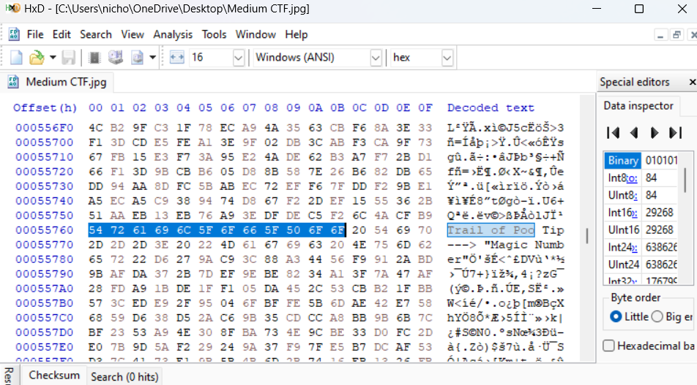

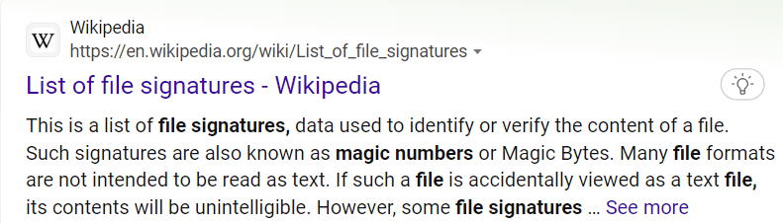
- The Search results will reveal a clue called “magic number” - Research “magic number” to reveal that it’s a another term for “file signatures”

Slide 6
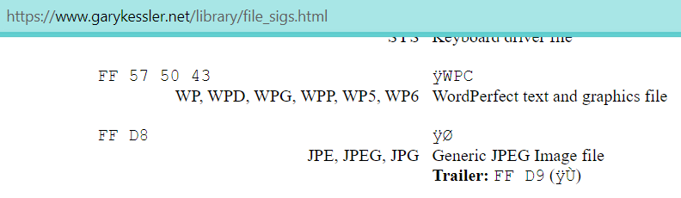
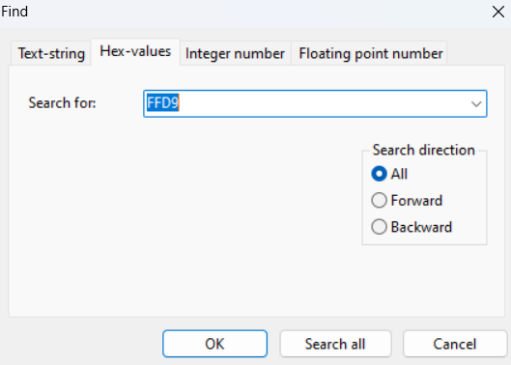
- Research the file signatures for .jpg file - Copy and paste the ending file signature for the .jpg into the “hex search query”

Slide 7
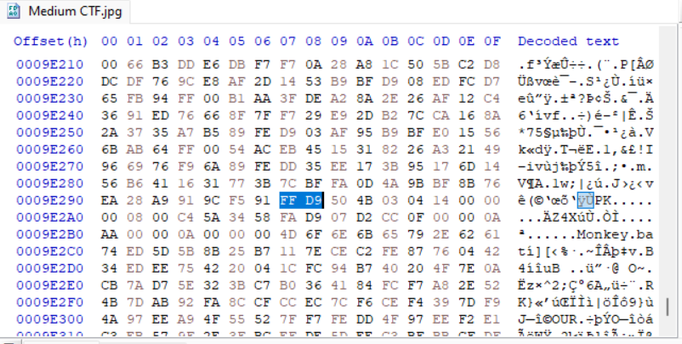

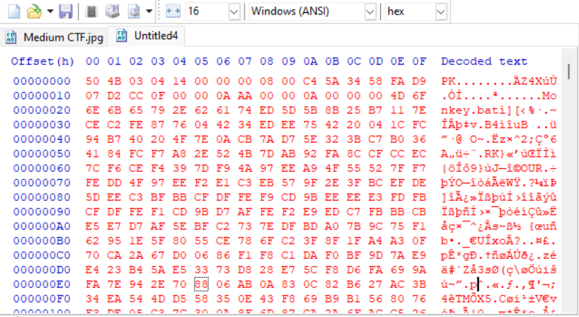
Create new empty file
- No Hex values should exist after this file this signature. - Extract the potential file by copying and pasting the remaining hex values into a new empty file.

Slide 8
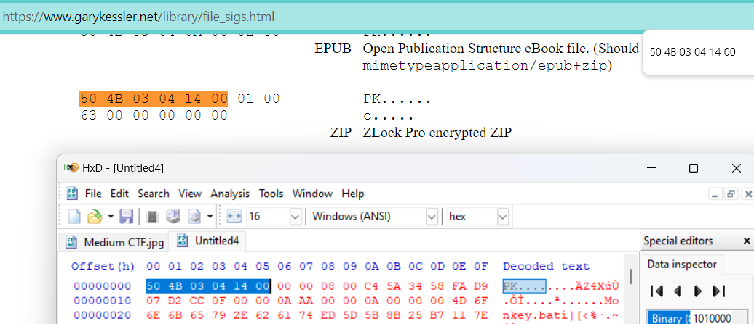
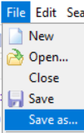

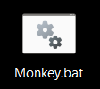
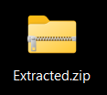
CTRL + F
- Do research and copy and paste portions of the beginning hex values to see if they match up with any potential file signatures. - Save the file as a .zip file. - Then unzip/extract the file.

Slide 9
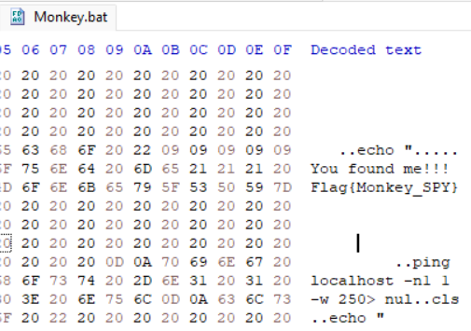
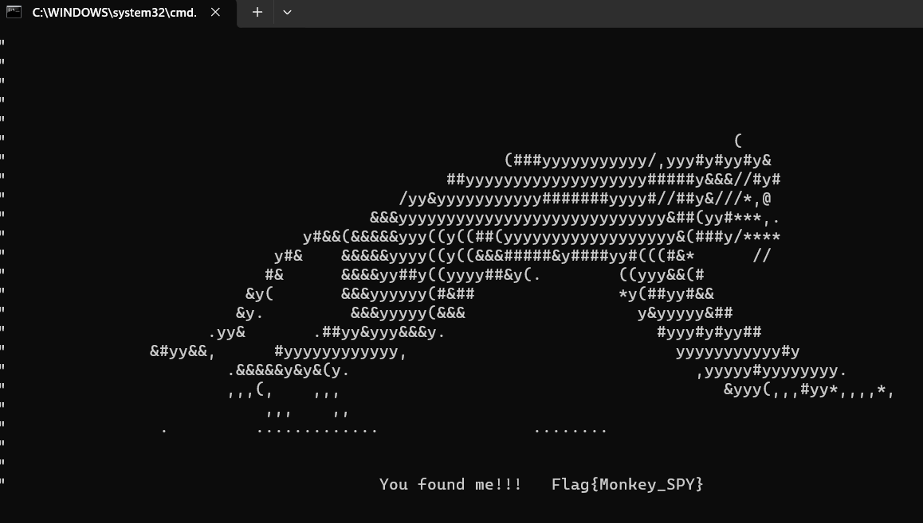
- Open the Monkey.bat file in the hex editor to reveal the flag. - The .bat file is safe you can run it if you’d like.

